Slide 1
STRINGS
BY
1831057
VIKASHINI.J.R

Slide 2
Strings
A char is a data type which is used to specify a string, like integer and floating point units are used to specify numbers, where as char is used to represent text rather than numbers
eg:- char name [50];
For eg:-
"hamburger"
"I ate 3 hamburgers"
"12345"

Slide 3
Null character
A | p | p | l | e | ‘\0’
[0] [1] [2] [3] [4] [5]... [49]
char s[50]=“Apple”;
Null character is used to terminate the string
Null character will get appended at the end by default

Slide 4
Initialization of String
char str [50] = “Hello World”;
char str [] = “Hello World”;
char str [50] = {‘H’,’e’,’l’,’l’,’o’,’ ’,’W’,’o’,’r’,’l’,’d’};
char str [] = {‘H’,’e’,’l’,’l’,’o’,’ ’,’W’,’o’,’r’,’l’,’d’};
char str [50]={‘H’,’e’,’l’,’l’,’o’,’ ’,’W’,’o’,’r’,’l’,’d’,’\0’};

Slide 5
Reading and writing a String
A string can be read and written using scanf and printf function using %s
scanf function reads a string until a whitespace character is encountered - scanf("%s",s)
Eg:- #include<stdio.h>
main ()
{
char s[50];
printf("Enter the string:”,s);
scanf("%s",s);
printf("You entered is %s\n",s);
}

Slide 6
OUTPUT:-
Enter the string:Hello
You entered is Hello
Another execution of the program will look like:
Enter the string:Hello World
You entered is Hello
What we want to do ,If we want to read a string consisting of blank characters as well as a line of text?
gets ( string_name) ;
puts (string) ;
scanf(“ %[^\n] ”,s) ,it reads a string until a new line character is encountered

Slide 7
Example:-
#include<stdio.h>
#include<string.h>
#define MAX_SIZE 50
main ()
{
char s[MAX_SIZE];
printf(“Enter the string:”,MAX_SIZE);
gets(s);
puts(“The entered line is:”);
puts(s);
}
OUTPUT:-
Enter the string:Hello World
The entered line is:Hello World

Slide 8
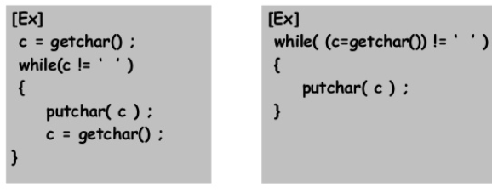
The string can be read or written character by character either by using:-
getchar
getc
-In both of these alternates, the null character needs to be appended by the user
-We can print the string as character by character using putchar/putc or printf with %c

Slide 9
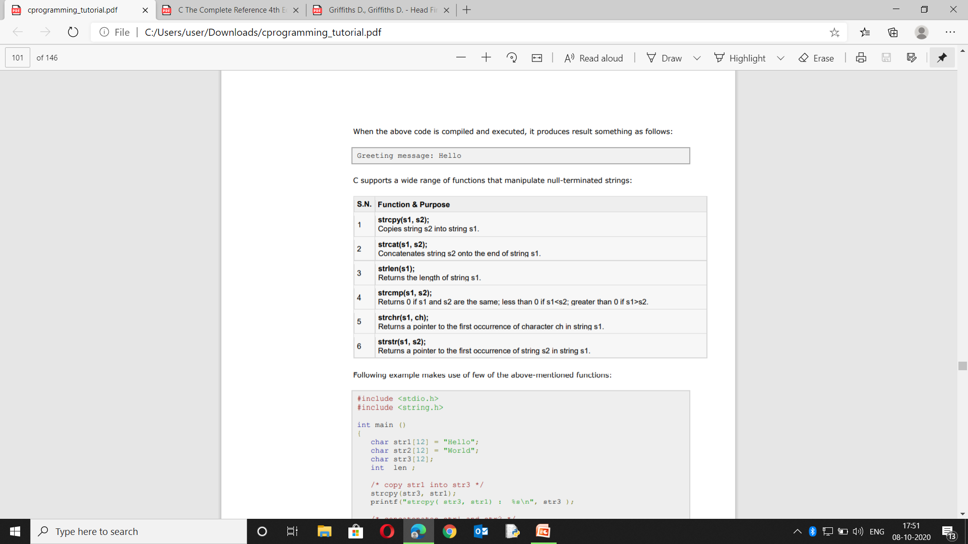
Processing the string

Slide 10
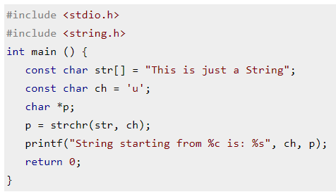
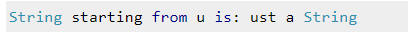
strchr()- searches the occurrence of a specified character in the given string and returns the pointer to it
output:-

Slide 11
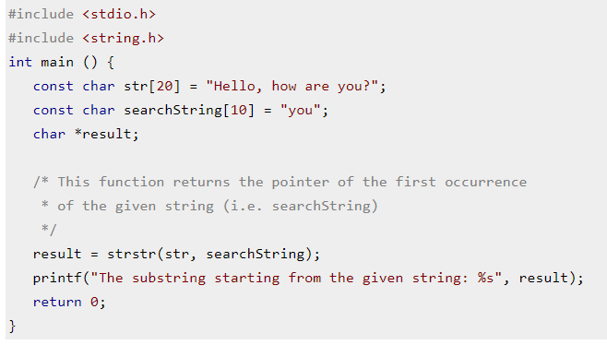
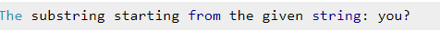
strstr() -searches the given string in the specified main string and returns the pointer to the first occurrence of the given string
Output:-

Slide 12
example with few of the above-mentioned functions:
#include <stdio.h>
#include <string.h>
int main ()
{
char str1[12] = "Hello";
char str2[12] = "World";
char str3[12];
int len ;
strcpy(str3, str1); /* copy str1 into str3 */
printf("strcpy( str3, str1) : %s\n", str3 );
strcat( str1, str2); /* concatenates str1 and str2 */
printf("strcat( str1, str2): %s\n", str1 );
len = strlen(str1); /* total lenghth of str1 after concatenation */
printf("strlen(str1) : %d\n", len );
return 0;
}

Slide 13
OUTPUT:-
strcpy( str3, str1) : Hello
strcat( str1, str2): HelloWorld
strlen(str1) : 10

Slide 14
Character arithmetic
Character arithmetic is used to implement arithmetic operations like addition and subtraction on characters.
Eg:- #include <stdio.h>
int main()
{
char alphabet1 = 'm';
char alphabet2 = 'z' - 'y';
printf("%d\n", alphabet1);
printf("%c\n", alphabet1);
printf("%d\n", (alphabet1+1));
printf("%c\n", (alphabet1+1));
printf("%d\n", (alphabet1-1));
printf("%c\n", (alphabet1-1));
printf("%d\n", alphabet2);
return 0;
}

Slide 15
Output:-
109
m
110
n
108
l
1

Slide 16
searching and sorting
There are the several internal sorting algorithm used in practical fields.
Bubble Sort
Selection Sort
Insertion Sort
Quick Sort
Heap Sort
Merge sort
There are two searching algorithms
Linear Search
Binary Search

Slide 17
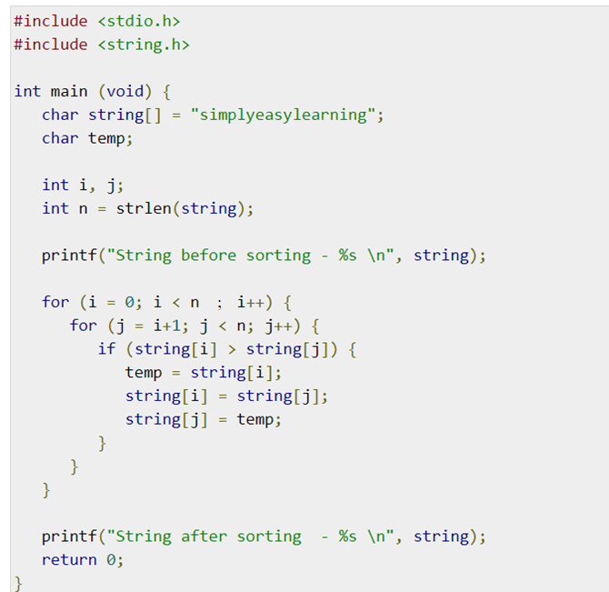
Sorting

Slide 18
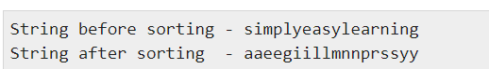
Output:-

Slide 19
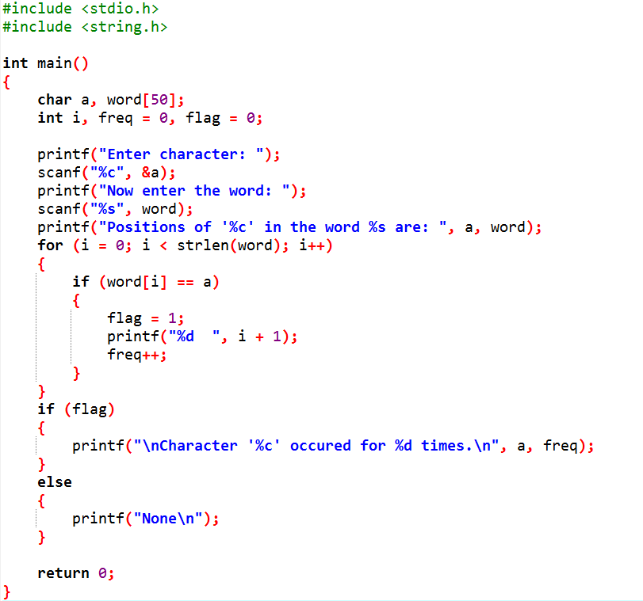
Searching:-

Slide 20
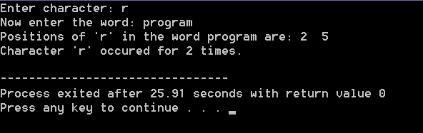
Output

Slide 21
Thank You...!

